Slide 1

Title: Central Karoo Community Network Project
Jake of All Trades
Main Group Members:
Bornwise Nkateko Baloyi (Group Leader)
Moshokoa Solomon Morongwa
Ramabulana Tshilidzi (Secretary)
Mokgadi Mamabolo

Slide 2


Summary Presentation: Interconnected Computer Network Proposal for Central Karoo
Table of Contents
Introduction
Background of the Project
Objectives and Aims
Body
4.1 Current Network Infrastructure
4.2 Proposed Network Design
4.3 Implementation Plan
4.4 Challenges and Solutions
Documentation
Conclusion

Slide 3


1. Introduction
This presentation outlines a proposal for developing an interconnected computer network in the Central Karoo district of South Africa. The aim is to improve connectivity for approximately 3,000 homes and support critical services in three district hospitals and a government administrative building.

Slide 4

2. Background of the Project
Central Karoo, located 417 km southeast of Cape Town, has transitioned from a railway-dependent economy to one relying primarily on agriculture. The area faces significant challenges regarding telecommunications, including poor internet connectivity and unreliable service. With the gradual rollout of 5G, there is an opportunity to enhance the digital landscape and service delivery in the region.

Slide 5
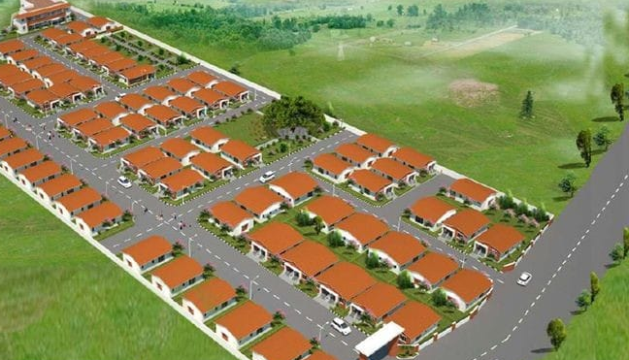
3. Objectives and Aims
Establish a reliable interconnected network: Provide intranet and internet access for local homes and institutions.
Enhance service delivery: Improve communication for hospitals and government services.
Ensure sustainability: Utilize funding from the mayor’s office to create a long-lasting network infrastructure.
Implement within one year: Complete the project efficiently and effectively.

Slide 6

4. Body
4.1 Current Network Infrastructure
Network Operating Center (NOC):
Consists of a battery storage room, server room, working space, and equipment storage.
Equipped with solar panels and backup power systems for sustainability.
Wireless Backbone Infrastructure:
Utilizes Smart Bridges multi-band access points for high-performance wireless links.
Network Topology:
Currently implemented in a star topology with two access points: one sectoral antenna and one omnidirectional antenna.

Slide 7

4.2 Proposed Network Design
Expansion of Access Points: Increase the number of access points to improve coverage and connectivity.
Integration of Fiber Optics: Consider fiber connections where feasible for higher speed and reliability.
Security Measures: Implement robust security protocols to address concerns related to external suppliers accessing government data.

Slide 8

4.3 Implementation Plan
Phase 1: Assessment and planning (Months 1-3)
Phase 2: Infrastructure setup (Months 4-8)
Phase 3: Testing and optimization (Months 9-10)
Phase 4: Final rollout and community training (Months 11-12)

Slide 9

4.4 Challenges and Solutions
Geographic Isolation: Utilize satellite technology to reach remote areas.
Funding Limitations: Explore partnerships with local businesses and NGOs for additional funding.
Community Engagement: Involve local stakeholders in planning and implementation to ensure buy-in and support.

Slide 10

5. Documentation
Network Infrastructure Diagrams
Work Breakdown (WBS)
Implementation Timeline
Budget Estimates
Security Protocols
Stakeholder Engagement Plan

Slide 11
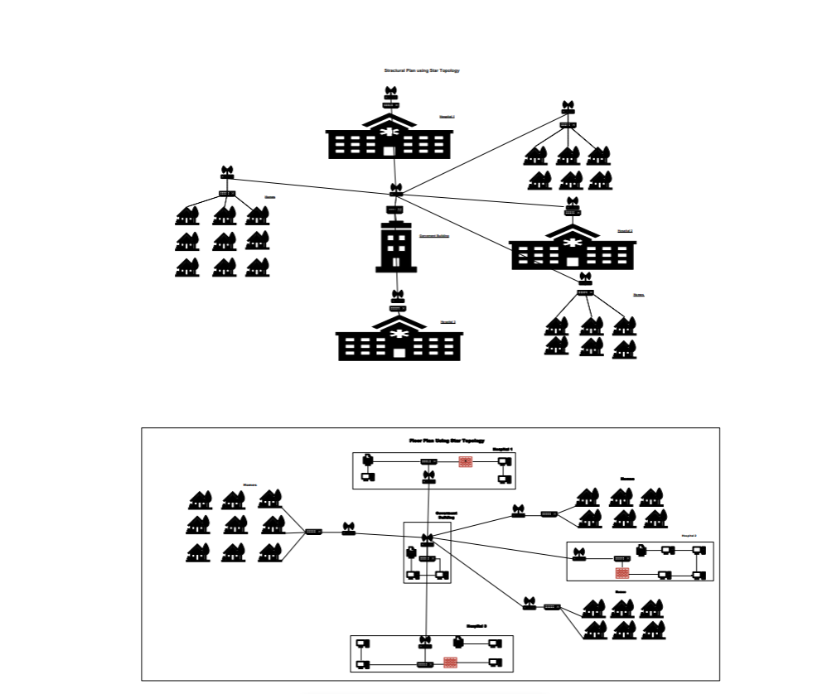
5.1.Network Infrastructure Diagrams

Slide 12
•Planning
1.2 Design and Planning1
1.1 Requirements Analysis
2. Procurement
2.1 Ordering and Receiving Equipment
3.Installation
3.1 Physical Setup of Hardware
3.2 Network Cabling and Connections
4. Configuration
4.1 Setting Up Network Devices
4.2 Implementing Security Protocols
5. Testing
5.1 Conducting Performance Tests
5.2 Verifying Network Reliability
6. Training
6.1 Preparing Training Materials
6.2 Conducting Training Sessions
7. Documentation
7.1 Creating Technical Documentation
7.2 Creating User Manuals

Slide 13

5.3.Implementation Timeline
1. Month 1-2: Project planning and stakeholder engagement.
2. Month 3-5: Infrastructure installation and testing.
3. Month 6: Community training and onboarding.
4. Month 7-9: Go live and monitor usage.
5. Month 10-12: Evaluate and refine services.

Slide 14
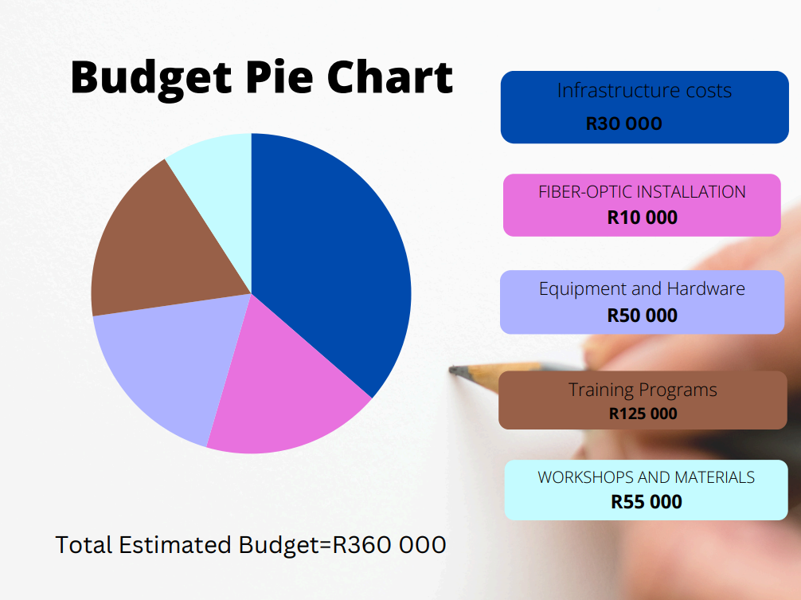
5.4. Budget Estimates
1. Infrastructure Costs: R30 000
Fiber-optic installation: R10 000
Equipment and hardware: R50 000
2. Training Programs: R125 000
Workshops and materials: R55 000
3. Ongoing Maintenance: R25 000
4. Annual support: R65 000
5. Total Estimated Budget: R360 000

Slide 15

5.5. Security Protocols
Implement the following security measures:
Network Access Control (NAC): To restrict access to authorized users only.
Virtual Private Network (VPN): For secure remote access to the network, especially for external suppliers.
Firewall and Intrusion Detection Systems (IDS): To monitor and protect against unauthorized access and threats.
Data Encryption: Utilize encryption protocols for sensitive data transmission, particularly in healthcare applications.
Regular Security Audits: Conduct routine checks to ensure compliance with security standards.

Slide 16

5.6.Key Stakeholders Engagement Plan
Local Government Officials:
Mayor's Office
District Council Members
Municipal IT Department
Healthcare Providers:
Hospital Administrators
Medical Staff (Doctors, Nurses, IT staff)
Community Representatives:
Local NGOs and Community Organizations
Residents’ Associations
Schools
External Suppliers:
Vendors providing IT equipment and services
Local Businesses:
Small business owners benefiting from improved connectivity
Technical Experts:
Network Engineers and IT Consultants

Slide 17

Engagement Strategies
Initial Stakeholder Meetings:
Monthly in-person and virtual meetings to gather feedback from key stakeholders.
Surveys and Feedback Forms:
Online and physical surveys to collect community input on connectivity needs.
Workshops and Focus Groups:
Bi-monthly interactive discussions with specific stakeholder groups on network features.
Regular Project Updates:
Bi-weekly newsletters and social media updates to keep all stakeholders informed.
Training Sessions:
Hands-on workshops before and after network rollout to ensure user proficiency.
Stakeholder Advisory Committee:
Monthly meetings with representatives from all stakeholder groups for ongoing feedback.

Slide 18

6. Conclusion
The proposal for an interconnected computer network in Central Karoo aims to significantly enhance communication capabilities, support local services, and improve overall quality of life for residents. With a strategic plan and community involvement, the project can overcome existing challenges and lay the foundation for a sustainable digital future.

